Slide 1
Causal Inference example

Slide 2
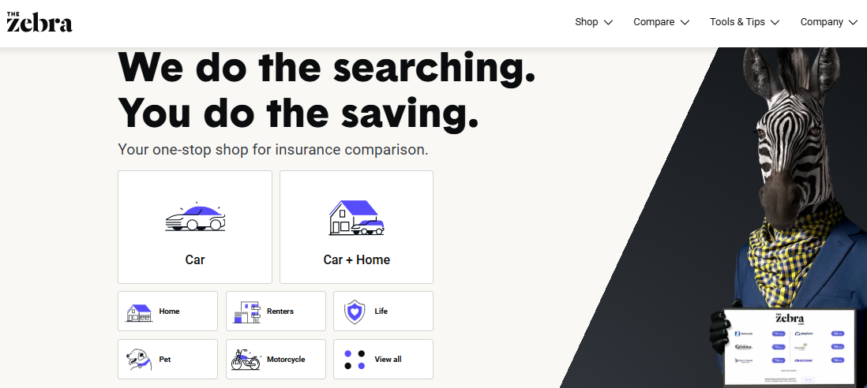
The Product

Slide 3
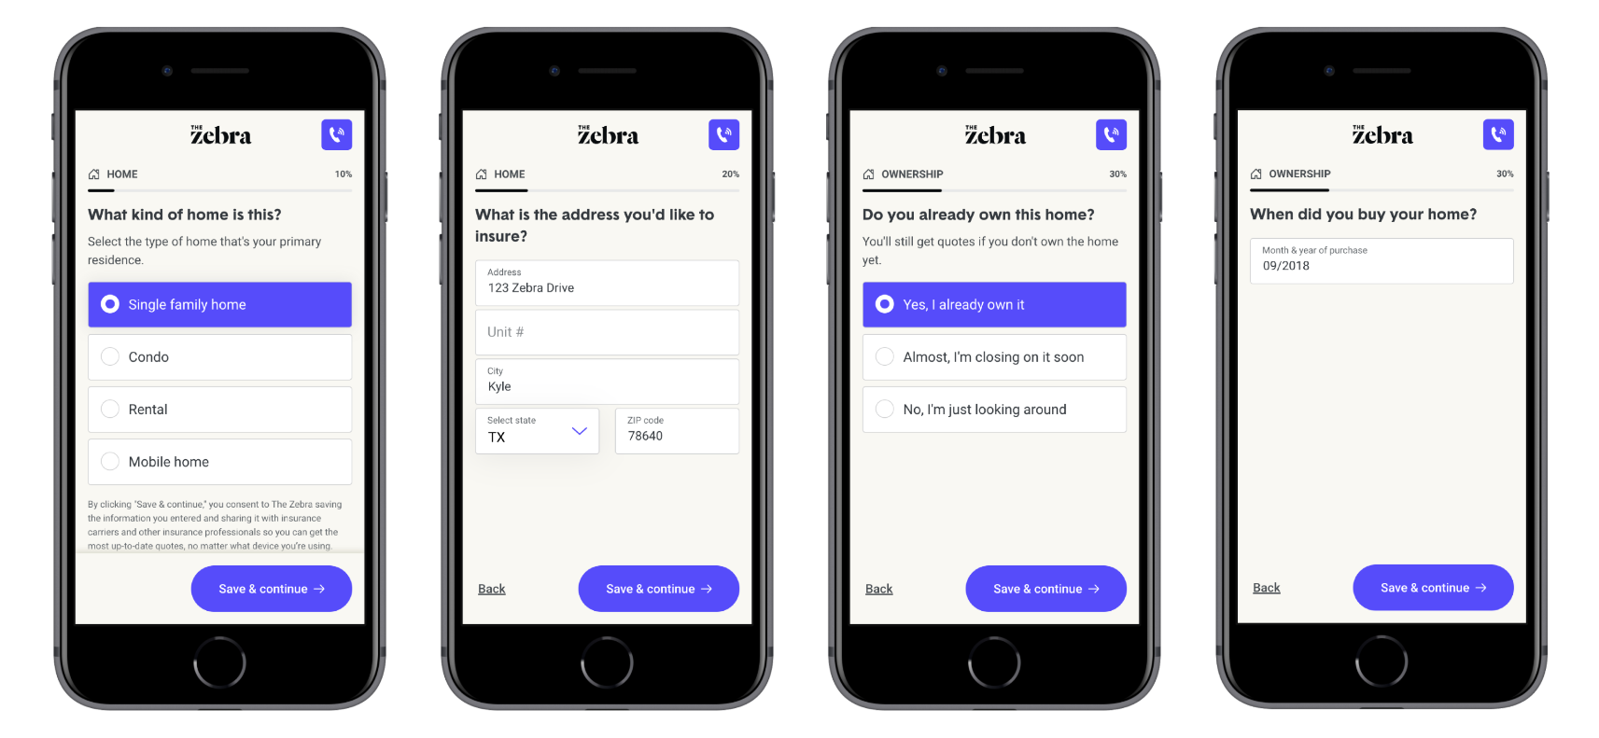
The Funnel
Visitors answer questions about their insurance needs and ideally receive many insurance policy options.

Slide 4
Marketing/Email
Integrations with Insurers
Comparing Policies UX
Early Funnel Qs?
The Agency (phone)
Website content/SEO
Bundling
Returning Customers
The Funnel
Each part of the Zebra purchasing funnel has a product manager and KPIs

Slide 5
Question:
What metric do we focus on?

Slide 6

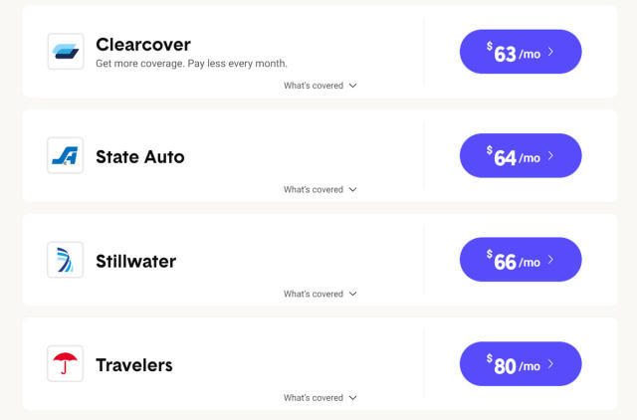
First Step
Question: Which metric impacts revenue per visitor the most?
Analytical Tool: Decision Tree and Random Forest
  Products:
    Visual of decision tree
    Random Forest Variable Importance ranking
Answer: Number of insurance quotes seen after filling out funnel questions
  Ideally: more than three policies to compare
  Orders of magnitude more impactful than any metric
Takeaway:
  Invest in more insurance relationships
  Market less in low density regions

Slide 7
First Step - Technique explained
What is a decision tree?
  Machine learning algorithm
  Splits data optimally to explain variation in desired metric
  Pros:
    Makes easy-to-understand visuals
  Cons
    Prone to overfitting if tuned incorrectly
    Other tools are generally better at predicting with new data
What is a random forest?
  Also ML algorithm
  Uses many decision trees with data split in many ways to find most predictive features
  Pros:
    Powerfully predictive
  Cons:
    Does not make similar visual to decision trees
    Harder to explain without branching output

Slide 8
First Step - variables considered
Variables:
  Time on site
  Number of visits
  Number of cars
  Income
  Age
  Region
  Regional marketing spend
  Recency of marketing spend
  Device type
  Time to complete funnel
  Number of insurance quotes seen
  Landing page type (SEO)
Variables cont:
  Is return user
  Clicked anywhere on results page
  Clicked to bundle insurance
  Marketing channel attribution
  Gender
  Clicked to see more quote info
  Clicked to change coverage type
  Logged into Account
  Stated Intent
  Insured Status
  etc.

Slide 9
Database: Snowflake
Data Source: Event-level SQL query and DBT data
Analytics Data layer: DBT
Consideration: First time the company is using decision tree and random forest for decision making
Data Visualization tool: Looker
Recommendation isn’t within Product’s control. Sorry not sorry
Analytics tool: R Studio
So there’s a next step for Product…
First Step Considerations/Background

Slide 10
Next Step - for Product Team
Question: Which metric impacts revenue per visitor the most that Product controls?
Analytical Tool: Causal Inference (propensity score)
  Products:
    Revenue multiplier for Applicants with activity
    Interactive tool to explore revenue impact of KPI improvements
Answer:
  Most impactful click for revenue: logging into account
    Applicants who log into account make 1.7x more revenue on average than similar other applicants
  Also, new feature for bundling home/auto insurance is actually losing revenue
Takeaway:
  Pause bundling until funnel KPIs improve
    This was a large mental shift: upended previous understanding
  Qualitative UX panel for account makers to understand why such an impact

Slide 11
Next Step - Technique Explained
What is Causal Inference (propensity score)
  Use variables related to a visitor with a particular site action and finds the most similar visitor without the action
  Then compare revenue between visitor with and without action
  Closest to “apples to apples” comparison we can do with data we have
  “The only thing we know that’s different between these 2 visitors is x action” lets us infer that the action “causes” the revenue difference
  Pro:
    New understanding of isolated impact of site action
  Con
    Difference in revenue may be explained by a variable we don’t collect
    ML can optimize to find best match but it’s not “perfect” because no two people are alike

Slide 12
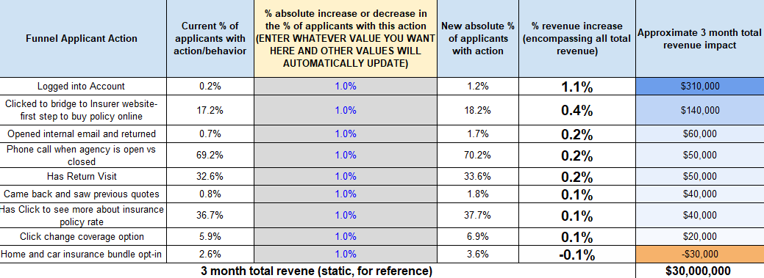
The Interactive Tool Demo

Slide 13
Analytic Outcomes
Pause bundle rollout - saves millions of dollars in potentially lost revenue
  Bundle revenue per applicant was very high but deceptive
    This analysis uncovered hidden cost of bundle: losing our most valuable potential customers
Product team further appreciates they are but players in vast ecosystem
  Humbled by insurance quote density being top predictor of revenue
  Passed off next analytic step of analysis: impact of increased insurance partners
Further invest in account creation
  All new features are AB tested, so the impact of investment is quantified in ordinary AB tests
Introduced Causal Inference to company
  Powerful tool to understand true apples to apples impact of product feature use
  Vital knowledge: Not all visitors are alike in potential revenue
    Now we know profile of most valuable customer, perhaps personal touch for VIPs?
Data-informed product prioritization
  Applying similar rigor to prioritization as company AB testing ethos

Slide 14
THANK YOU

